Slide 1
数据查询与事务控制 —SELECT进阶单行函数
3

Slide 2
单行函数
字符
其它
数字
Single-row
functions
转换
日期(Date)

Slide 3
1.1 字符函数:分类
字符函数
字符大小写转换函数
字符处理函数
LOWER
UPPER
INITCAP
CONCAT
SUBSTR
LENGTH
INSTR
LPAD

Slide 4
1.2 字符函数:常用函数列表
函数 | 说 明
LPAD(X, Y [,Z]) | 在字符串X的左边加入字符Z（默认的字符是空格），加入字符的个数为Y。
RPAD(X, Y [,Z]) | 在字符串X的右边加入字符Z（默认的字符是空格），加入字符的个数为Y。
LOWER(X) | 把字符串X所有的字符转换成小写。
UPPER(X) | 把字符串X所有的字符转换成大写
INITCAP(X) | 把字符串X的每个英文单词的第一个字符转换成大写，其它字符转换的成小写。
LENGTH(X) | 返回字符串X的长度。
SUBSTR(X, Y [,Z]) | 从字符串X的第Y个字符开始，取出Z个字符（默认取出所有字符）。
INSTR(X, Y) | 字符串Y在字符串X中的位置。
CONCAT(X, Y) | 把字符串X和字符串Y连接在一起。

Slide 5
1.3 字符函数：用例
SQL> SELECT ename, CONCAT (ename, job), LENGTH(ename),
2 INSTR(ename, 'A')
3 FROM emp
4 WHERE
SUBSTR(job,1,5) = 'SALES';
ENAME CONCAT(ENAME,JOB) LENGTH(ENAME) INSTR(ENAME,'A')
---------- ------------------- ------------- ----------------
MARTIN MARTINSALESMAN 6 2
ALLEN ALLENSALESMAN 5 1
TURNER TURNERSALESMAN 6 0
WARD WARDSALESMAN 4 2

Slide 6
2.1 数值函数:常用函数列表
数值函数 | 返回值
ABS(n) | 绝对值
ROUND(n [,m]) | 返回将 n 四舍五入到小数点右边 m 位的值。当 m 忽略时，四舍五入到个位。当 m 为负时，四舍五入到下数点左边数字。
CEIL(n) | 返回大于或等于 n 的最小整数。
FLOOR(n) | 返回等于或小于 n 的最大整数。
MOD(m,n) | 返回 m 除以 n 的余数，如果 n=0，则返回 m。
SIGN(n) | 当 n<0，返回 -1，当 n=0，返回 0，当 n>0，返回 1。
SQRT(n) | 返回 n 的平方根。
TRUNC(n [,m]) | 返回在 m 位截断的 n 值，当 m 忽略，在 0 位截断；m 为负，将小数点左边 m 个数字截断。

Slide 7
2.2 数值函数： ROUND函数
SQL> SELECT ROUND(45.923,2), ROUND(45.923,0),
2 ROUND(45.923,-1)
3 FROM DUAL;
ROUND(45.923,2) ROUND(45.923,0) ROUND(45.923,-1)
--------------- -------------- -----------------
45.92 46 50

Slide 8
2.3 数值函数： TRUNC函数
SQL> SELECT TRUNC(45.923,2), TRUNC(45.923),
2 TRUNC(45.923,-1)
3 FROM DUAL;
TRUNC(45.923,2) TRUNC(45.923) TRUNC(45.923,-1)
--------------- ------------- ---------------
45.92 45 40

Slide 9
2.4 数值函数： MOD函数
SQL> SELECT ename, sal, comm, MOD(sal, comm)
2 FROM emp
3 WHERE job = 'SALESMAN';
ENAME SAL COMM MOD(SAL,COMM)
---------- --------- --------- -------------
MARTIN 1250 1400 1250
ALLEN 1600 300 100
TURNER 1500 0 1500
WARD 1250 500 250

Slide 10
3.1日期类型
日期类型：
Oracle是用数字来存储日期信息，数字的整数部分代表与Julian Calendar（罗马儒略历，公历）相距的天数 （由公元前4712年1月1日开始），而小数部分代表时、分和秒。
Oracle默认日期格式：DD-MON-YY
SYSDATE函数返回系统当前的日期和时间。
DUAL是Oracle内置的虚拟表，只有一行一列。
SELECT SYSDATE FROM DUAL;
SELECT TO_CHAR(SYSDATE,'YYYY-MM-DD HH24:MI:SS') FROM DUAL;

Slide 11
3.2日期运算
日期运算：不允许日期加日期
SQL> SELECT ename, (SYSDATE-hiredate)/7 WEEKS
2 FROM emp
3 WHERE deptno = 10;
ENAME WEEKS
---------- ---------
KING 830.93709
CLARK 853.93709
MILLER 821.36566
Notes:
Arithmetic with Dates
Since the database stores dates as numbers, you can perform calculations using arithmetic operators such as addition and subtraction. You can add and subtract number constants as well as dates.
You can perform the following operations:

Slide 12
3.3 日期函数
Function
Description
MONTHS_BETWEEN(date1,date2)
两个日期间相差的月数
ADD_MONTHS(date,number)
增加number月的日期
NEXT_DAY(date,day)
返回指定date后，由day命名的第一周的日期
LAST_DAY(date)
返回date所在月份最后一天的日期
ROUND(date [,fmt])
Round date
TRUNC(d [,fmt])
Truncate date

Slide 13
3.4 日期函数：应用举例
19.6774194
MONTHS_BETWEEN ('01-SEP-95','11-JAN-94')
ADD_MONTHS ('11-JAN-94',6)
'11-JUL-94'
'08-SEP-95'
NEXT_DAY ('01-SEP-95','FRIDAY')
LAST_DAY('01-FEB-95')
'28-FEB-95'
设 SYSDATE = '25-JUL-95':
ROUND(SYSDATE,'MONTH') 01-AUG-95
ROUND(SYSDATE ,'YEAR') 01-JAN-96
TRUNC(SYSDATE ,'MONTH') 01-JUL-95
TRUNC(SYSDATE ,'YEAR') 01-JAN-95

Slide 14
4 转换函数
数据类型
转换
隐式转换
显示转换
Notes:
Conversion Functions
In addition to Oracle data types, columns of tables in an Oracle9i database can be defined using ANSI, DB2, and SQL/DS data types. However, the Oracle server internally converts such data types to Oracle data types.
In some cases, Oracle server uses data of one data type where it expects data of a different data type. When this happens, Oracle server can automatically convert the data to the expected data type. This data type conversion can be done implicitly by Oracle server, or explicitly by the user.
Implicit data type conversions work according to the rules explained in the next two slides.
Explicit data type conversions are done by using the conversion functions. Conversion functions convert a value from one data type to another. Generally, the form of the function names follows the convention data type TO data type. The first data type is the input data type; the last data type is the output.
Note: Although implicit data type conversion is available, it is recommended that you do explicit data type conversion to ensure the reliability of your SQL statements.

Slide 15
4.1 隐式转换-赋值
在赋值时，Oracle服务器能够进行自动转换的数据类型列表：
From
To
VARCHAR2 or CHAR
NUMBER
VARCHAR2 or CHAR
DATE
NUMBER
VARCHAR2
DATE
VARCHAR2

Slide 16
4.1 隐式转换-表达式运算
在表达式运算时，Oracle服务器能够进行自动转换的数据类型列表：
From
To
VARCHAR2 or CHAR
NUMBER
VARCHAR2 or CHAR
DATE

Slide 17
4.2 显示转换
TO_NUMBER
TO_DATE
NUMBER
CHARACTER
DATE
TO_CHAR
TO_CHAR

Slide 18
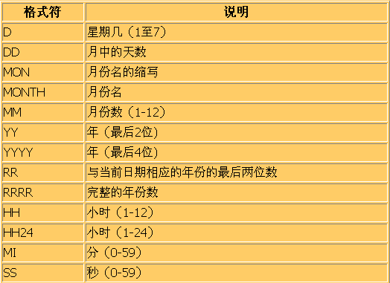
4.2.1 函数TO_CHAR (日期)
TO_CHAR(date, 'format_model') ‘YYYY-MM-DD HH24:MI:SS’
函数TO_CHAR的第二个参数的转换格式(日期)：

Slide 19
4.2.2 函数TO_CHAR (日期)
SQL> SELECT ename,
2 TO_CHAR(hiredate, ‘DD Month YYYY') HIREDATE
3 FROM emp;
ENAME HIREDATE
---------- -----------------
KING 17 November 1981
BLAKE 1 May 1981
CLARK 9 June 1981
JONES 2 April 1981
MARTIN 28 September 1981
ALLEN 20 February 1981
...
14 rows selected.

Slide 20
4.2.3 函数TO_CHAR (数值)
TO_CHAR(number, 'format_model')
函数TO_CHAR的第二个参数的转换格式（数值）
9
返回指定位数的数值
0
在0的位置，对0值或值的前面的0以0表示，而不用空格
$
在返回值前添加$符号
L
在指定的位置返回国家货币符号
.
插入小数点
,
在指定的位置插入逗号

Slide 21
4.2.4 函数TO_CHAR (数值)
SELECT TO_CHAR(sal, '$99,999.00') SALARY
FROM emp;
SELECT TO_CHAR(0123.12, ‘0999.00') SALARY
FROM DUAL;
SALAR
--------------------------
0123.12

Slide 22
4.2.5 函数TO_NUMBER TO_DATE
TO_NUMBER(char[, 'format_model'])
TO_DATE(char[, 'format_model'])
Notes:
The TO_NUMBER and TO_DATE Functions
You may want to convert a character string to either a number or a date. To accomplish this task, use the TO_NUMBER or TO_DATE functions. The format model you choose is based on the previously demonstrated format elements.
The “fx” modifier specifies exact matching for the character argument and date format model of a TO_DATE function:
Punctuation and quoted text in the character argument must exactly match (except for case) the corresponding parts of the format model.
The character argument cannot have extra blanks. Without fx, Oracle ignores extra blanks.
Numeric data in the character argument must have the same number of digits as the corresponding element in the format model. Without fx, numbers in the character argument can omit leading zeroes.
The TO_NUMBER and TO_DATE Functions (continued)
Example
Display the names and hire dates of all the employees who joined on May 24, 1999. Because the fx modifier is used, an exact match is required and the spaces after the word ‘May’ are not recognized.
SELECT last_name, hire_date
FROM employees
WHERE hire_date = TO_DATE('May 24, 1999', 'fxMonth DD, YYYY');

Slide 23
4.3 空值置换函数
空值置换函数NVL ：如果表达式expr1为NULL ，就返回expr2的值.否则，函数就返回表达式expr1的值。
NVL (expr1, expr2)
NVL2 (expr1, expr2, expr3)
空值置换函数NVL2 ：如果表达式expr1为NULL ，就返回expr3的值.否则，函数就返回表达式expr2的值。
Notes:
The TO_NUMBER and TO_DATE Functions
You may want to convert a character string to either a number or a date. To accomplish this task, use the TO_NUMBER or TO_DATE functions. The format model you choose is based on the previously demonstrated format elements.
The “fx” modifier specifies exact matching for the character argument and date format model of a TO_DATE function:
Punctuation and quoted text in the character argument must exactly match (except for case) the corresponding parts of the format model.
The character argument cannot have extra blanks. Without fx, Oracle ignores extra blanks.
Numeric data in the character argument must have the same number of digits as the corresponding element in the format model. Without fx, numbers in the character argument can omit leading zeroes.
The TO_NUMBER and TO_DATE Functions (continued)
Example
Display the names and hire dates of all the employees who joined on May 24, 1999. Because the fx modifier is used, an exact match is required and the spaces after the word ‘May’ are not recognized.
SELECT last_name, hire_date
FROM employees
WHERE hire_date = TO_DATE('May 24, 1999', 'fxMonth DD, YYYY');

Slide 24
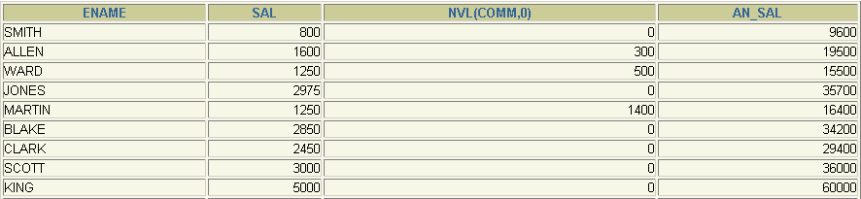
4.3.1 空值置换函数: NVL函数
函数可以使用date, character, 和number数据类型。
表达式的值和替换值类型必须匹配:
NVL(comm,0)
NVL(hiredate,'01-JAN-97')
NVL(job,'No Job Yet')
1
SELECT Ename, sal, NVL(comm, 0),
(sal*12) + NVL(comm, 0) AN_SAL
FROM emp;
2
1
2
Notes:
The TO_NUMBER and TO_DATE Functions
You may want to convert a character string to either a number or a date. To accomplish this task, use the TO_NUMBER or TO_DATE functions. The format model you choose is based on the previously demonstrated format elements.
The “fx” modifier specifies exact matching for the character argument and date format model of a TO_DATE function:
Punctuation and quoted text in the character argument must exactly match (except for case) the corresponding parts of the format model.
The character argument cannot have extra blanks. Without fx, Oracle ignores extra blanks.
Numeric data in the character argument must have the same number of digits as the corresponding element in the format model. Without fx, numbers in the character argument can omit leading zeroes.
The TO_NUMBER and TO_DATE Functions (continued)
Example
Display the names and hire dates of all the employees who joined on May 24, 1999. Because the fx modifier is used, an exact match is required and the spaces after the word ‘May’ are not recognized.
SELECT last_name, hire_date
FROM employees
WHERE hire_date = TO_DATE('May 24, 1999', 'fxMonth DD, YYYY');

Slide 25
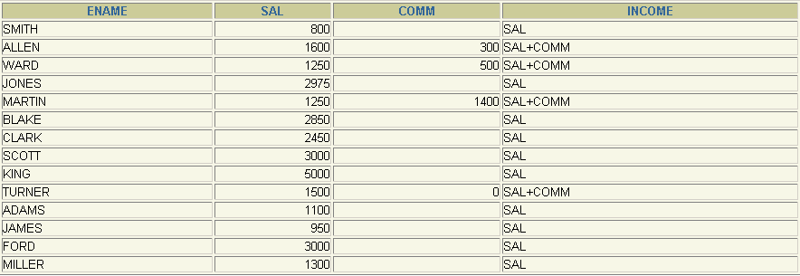
4.3.2 空值置换函数: NVL2函数
1
SELECT ename, sal, comm,
NVL2(comm,
'SAL+COMM', 'SAL') income
FROM emp;
2
1
2
Notes:
The NVL2 Function
The NVL2 function examines the first expression. If the first expression is not null, then the NVL2 function returns the second expression. If the first expression is null, then the third expression is returned.
Syntax
NVL(expr1, expr2, expr3)
In the syntax:
expr1 is the source value or expression that may contain null
expr2 is the value returned if expr1 is not null
expr3 is the value returned if expr2 is null
In the example shown, the COMMISSION_PCT column is examined. If a value is detected, the second expression of SAL+COMM is returned. If the COMMISSION_PCT column holds a null values, the third expression of SAL is returned.
The argument expr1 can have any data type. The arguments expr2 and expr3 can have any data types except LONG. If the data types of expr2 and expr3 are different, The Oracle server converts expr3 to the data type of expr2 before comparing them unless expr3 is a null constant. In that case, a data type conversion is not necessary.
The data type of the return value is always the same as the data type of expr2, unless expr2 is character data, in which case the return value’s data type is VARCHAR2.

Slide 26
4.4 条件表达式
条件表达式：在SQL语句内，提供的IF-THEN-ELSE逻辑表达式。有两种方法:
CASE表达式
DECODE函数
Notes:
Conditional Expressions
Two methods used to implement conditional processing (IF-THEN-ELSE logic) within a SQL statement are the CASE expression and the DECODE function.
Note: The CASE expression is new in the Oracle9i Server release. The CASE expression complies with ANSI SQL; DECODE is specific to Oracle syntax.

Slide 27
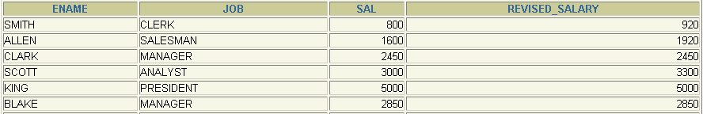
4.4.1 条件表达式： CASE表达式
CASE expr WHEN comparison_expr1 THEN return_expr1
[WHEN comparison_expr2 THEN return_expr2
WHEN comparison_exprn THEN return_exprn
ELSE else_expr]
END
SELECT ename, job, sal,
CASE job WHEN 'ANALYST' THEN 1.10*sal
WHEN 'CLERK' THEN 1.15*sal
WHEN 'SALESMAN' THEN 1.20*sal
ELSE sal
END
REVISED_SALARY
FROM emp;
Notes:
The CASE Expression
CASE expressions let you use IF-THEN-ELSE logic in SQL statements without having to invoke procedures.
In a simple CASE expression, Oracle searches for the first WHEN ... THEN pair for which expr is equal to comparison_expr and returns return_expr. If none of the WHEN ... THEN pairs meet this condition, and an ELSE clause exists, then Oracle returns else_expr. Otherwise, Oracle returns null. You cannot specify the literal NULL for all the return_exprs and the else_expr.
All of the expressions ( expr, comparison_expr, and return_expr) must be of the same data type, which can be CHAR, VARCHAR2, NCHAR, or NVARCHAR2.
Instructor Note
There is also a searched CASE expression. Oracle searches from left to right until it finds an occurrence of a condition that is true, and then returns return_expr. If no condition is found to be true, and an ELSE clause exists, Oracle returns else_expr. Otherwise Oracle returns null. For more information, see Oracle9i SQL Reference, “Expressions.”

Slide 28
4.4.2 条件表达式： DECODE函数
DECODE(col|expression, search1, result1
[, search2, result2,...,]
[, default])
SELECT ename, job, sal,
DECODE(job, 'ANALYST', 1.10*sal,
'CLERK', 1.15*sal,
'SALESMAN', 1.20*sal,
sal)
REVISED_SALARY
FROM emp;
NVL2(comm, 'SAL+COMM', 'SAL‘)
Notes:
The DECODE Function
The DECODE function decodes an expression in a way similar to the IF-THEN-ELSE logic used in various languages. The DECODE function decodes expression after comparing it to each search value. If the expression is the same as search, result is returned.
If the default value is omitted, a null value is returned where a search value does not match any of the result values.

Slide 29
4.4.2 条件表达式： DECODE函数
SELECT ename, sal,
DECODE (TRUNC(sal/2000, 0),
0, 0.00,
1, 0.09,
2, 0.20,
3, 0.30,
4, 0.40,
5, 0.42,
6, 0.44,
0.45) TAX_RATE
FROM emp
WHERE deptno = 30;
Notes:
Example
This slide shows another example using the DECODE function. In this example, we determine the tax rate for each employee in department 80 based on the monthly salary. The tax rates are as per the values mentioned in the following data.
Monthly Salary Range Rate
$0.00 - 1999.99 00%
$2,000.00 - 3,999.99 09%
$4,000.00 - 5,999.99 20%
$6,000.00 - 7,999.99 30%
$8,000.00 - 9,999.99 40%
$10,000.00 - 11,999.99 42%
$12,200.00 - 13,999.99 44%
$14,000.00 or greater 45%

Slide 30
5 函数的嵌套
单行函数能够在任何一个层次嵌套。
F3(F2(F1(col,arg1),arg2),arg3)
Step 1 = Result 1
Step 2 = Result 2
Step 3 = Result 3
SELECT Ename,
NVL(TO_CHAR(mgr), 'No Manager')
FROM emp
WHERE mgr IS NULL;
Notes:
The TO_NUMBER and TO_DATE Functions
You may want to convert a character string to either a number or a date. To accomplish this task, use the TO_NUMBER or TO_DATE functions. The format model you choose is based on the previously demonstrated format elements.
The “fx” modifier specifies exact matching for the character argument and date format model of a TO_DATE function:
Punctuation and quoted text in the character argument must exactly match (except for case) the corresponding parts of the format model.
The character argument cannot have extra blanks. Without fx, Oracle ignores extra blanks.
Numeric data in the character argument must have the same number of digits as the corresponding element in the format model. Without fx, numbers in the character argument can omit leading zeroes.
The TO_NUMBER and TO_DATE Functions (continued)
Example
Display the names and hire dates of all the employees who joined on May 24, 1999. Because the fx modifier is used, an exact match is required and the spaces after the word ‘May’ are not recognized.
SELECT last_name, hire_date
FROM employees
WHERE hire_date = TO_DATE('May 24, 1999', 'fxMonth DD, YYYY');

Slide 31
Thank You! to be continued
3

